Slide 1


Jericho Ross R. Operio
22 Dec 2025

Slide 2

Outline
Executive Summary
Introduction
Methodology
Results
Conclusion
Appendix

Slide 3
Executive Summary
Launch data was collected through web scraping and API access, then cleaned and prepared through structured data wrangling
Preliminary exploratory data analysis was conducted using SQLite to examine trends and relationships within the dataset
Further EDA and visualization were performed to identify key patterns related to landing outcomes
Interactive visual analytics were developed using Folium and Dash to explore spatial and operational insights
Predictive analysis was conducted using machine learning classification models, including Logistic Regression, SVM, Decision Tree, and KNN

Slide 4
Executive Summary
Logistic Regression, SVM, and KNN achieved the highest test accuracy (83.3%) with identical confusion matrices, indicating consistent and stable predictions
The Decision Tree model showed lower performance (77.8%), suggesting reduced generalization on the available dataset
Logistic Regression was selected as the final model due to its strong performance, simplicity, and interpretability
Overall, the project demonstrates that Falcon 9 first-stage landing success can be reliably predicted, supporting data-driven cost estimation and competitive launch analysis

Slide 5
Introduction
SpaceX’s Falcon 9 launch system significantly reduces launch costs through first-stage reusability
Falcon 9 launches are advertised at approximately $62 million, compared to $165 million or more from competing providers
The primary source of cost savings is SpaceX’s ability to successfully land and reuse the first-stage booster
Accurately predicting first-stage landing success enables estimation of true launch costs
Such predictions provide valuable insights for competing aerospace companies when bidding against SpaceX for launch contracts
This capstone project applies data analytics and machine learning techniques to predict Falcon 9 first-stage landing outcomes

Slide 6
Introduction
Since Falcon 9’s cost advantage relies heavily on successful first-stage recovery, accurately assessing landing outcomes is essential for understanding true launch costs
Landing success depends on multiple mission and booster-related factors, making outcomes non-trivial to predict
Using historical Falcon 9 launch data, this capstone project seeks to:
Predict whether the first-stage booster will land successfully
Evaluate the effectiveness of machine learning classification models in making this prediction
Compare model performance to identify the most reliable approach
The resulting predictions can support data-driven cost estimation and inform competitive decision-making in the commercial launch market

Slide 7

Section 1

Slide 8
Methodology
Executive Summary
Data collection methodology:
Collected Falcon 9 launch data through web scraping and public APIs
Perform data wrangling
Cleaned and processed raw data to handle missing values and inconsistencies
Perform exploratory data analysis (EDA) using visualization and SQL
Perform interactive visual analytics using Folium and Plotly Dash
Perform predictive analysis using classification models
Built and evaluated classification models to predict first-stage landing success
Tuned model hyperparameters using cross-validation
Compared model performance to identify the most effective approach

Slide 9
Data Collection
Collected launch and mission data from the SpaceX REST API and cleaned the responses
Web-scraped Falcon 9 launch records from Wikipedia using BeautifulSoup
Extracted and parsed HTML tables into Pandas Dataframes
Integrated API and scraped datasets into a single unified dataset for analysis and modeling
SpaceX API
API Dataset
Data Integration
Unified Dataset
Wikipedia (HTML tables)
Scraping Dataset

Slide 10
Data Collection – SpaceX API
Retrieved launch data via SpaceX REST API (GET requests)
Parsed and normalized JSON responses into tabular format
Extracted booster, payload, launch site, and landing attributes
Filtered Falcon 9 launches and handled missing values
https://github.com/operiojrr/IBM-Data-Science-Track-Outputs/blob/main/Applied%20Data%20Science%20Capstone%20Project/jupyter-labs-spacex-data-collection-api.ipynb
SpaceX REST API
Launch Data (JSON)
Normalize & Resolve IDs
Feature Extraction
Clean & Filter Data
Falcon 9 API Dataset

Slide 11
Data Collection - Scraping
Scraped Falcon 9 launch records from Wikipedia using BeautifulSoup
Retrieved HTML page via HTTP GET request
Identified and extracted the launch records table
Parsed table headers and rows into structured data
Converted cleaned records into a Pandas DataFrame
https://github.com/operiojrr/IBM-Data-Science-Track-Outputs/blob/main/Applied%20Data%20Science%20Capstone%20Project/jupyter-labs-webscraping.ipynb
Wikipedia Launch Page
HTTP GET Request
Parse HTML (BeautifulSoup)
Extract Table Headers & Rows
Clean & Structure Data
Falcon 9 Wiki Dataset

Slide 12
Data Wrangling
Loaded unified Falcon 9 launch dataset
Analyzed missing values
Identified numerical and categorical features
Performed exploratory analysis on launch sites, orbits, and outcomes
Converted landing outcomes into binary training labels
Prepared final dataset for machine learning
https://github.com/operiojrr/IBM-Data-Science-Track-Outputs/blob/main/Applied%20Data%20Science%20Capstone%20Project/labs-jupyter-spacex-Data%20wrangling.ipynb
Unified Launch Dataset
Missing Value Analysis
Feature Type Identification
EDA (Launch Sites, Orbits, Outcomes)
Model-Ready Dataset
Binary Label Creation (0 / 1)
Landing Outcome Mapping

Slide 13
EDA with Data Visualization
Key Visualizations Used:
Bar charts
Launch success vs. failure
Number of launches by launch site
Distribution of orbit types
Scatter plots
Payload mass vs. landing success
Flight number vs. landing outcome
Categorical plots
Landing outcome by orbit type
Landing outcome by launch site
Why These Visualizations
Identify patterns and trends affecting first-stage landing success
Examine relationships between mission parameters (orbit, payload, site) and outcomes
Detect imbalances or biases in categorical variables
Support feature selection for predictive modeling
Key Insights
Landing success improves with increasing flight number
Certain orbits and launch sites show higher success rates
Higher payload mass tends to reduce landing success probability
https://github.com/operiojrr/IBM-Data-Science-Track-Outputs/blob/main/Applied%20Data%20Science%20Capstone%20Project/edadataviz.ipynb

Slide 14
EDA with SQL
SQL Analysis Tasks Performed:
Queried unique launch sites and filtered launches by site name patterns
Retrieved specific launch records using conditional string matching
Aggregated total and average payload mass by customer and booster version
Identified the earliest successful ground-pad landing using date aggregation
Filtered launches by landing outcome, payload mass range, and booster type
Counted and compared successful vs. failed mission outcomes
Used subqueries to identify boosters carrying maximum payload mass
Extracted time-based insights (year and month) from launch dates
Ranked landing outcome frequencies over a specified historical period
https://github.com/operiojrr/IBM-Data-Science-Track-Outputs/blob/main/Applied%20Data%20Science%20Capstone%20Project/jupyter-labs-eda-sql-coursera_sqllite.ipynb

Slide 15
Build an Interactive Map with Folium
Map Objects Created
Folium Map centered at NASA Johnson Space Center for geographic context
Circle markers to highlight and label each SpaceX launch site
Standard markers to pinpoint exact launch site locations
Color-coded markers (green/red) to represent successful vs. failed launches
Marker clusters to manage overlapping launch records at the same site
MousePosition plugin to dynamically display geographic coordinates
Polylines to visualize distances between launch sites and nearby features (e.g., coastline)
https://github.com/operiojrr/IBM-Data-Science-Track-Outputs/blob/main/Applied%20Data%20Science%20Capstone%20Project/lab_jupyter_launch_site_location.ipynb
Why These Objects Were Used
Visualize the global and regional distribution of Falcon 9 launch sites
Compare launch success rates by location using interactive, color-coded markers
Reduce visual clutter and improve interpretability with marker clustering
Analyze geographic proximity to coastlines, highways, and railways
Support exploration of spatial factors influencing launch site selection and success
Key Insights
Launch sites are generally close to coastlines, supporting safe recovery operations
Sites maintain distance from dense urban areas, reducing operational risk
Geographic location appears to influence launch success patterns

Slide 16
Build a Dashboard with Plotly Dash
Plots and Interactions Added
Launch Site Dropdown
- Allows selection of all sites or a specific launch site
Success vs. Failure Pie Chart
- Displays total successful launches for all sites
- Shows success vs. failure breakdown for a selected site
Payload Range Slider
- Enables dynamic filtering of launches by payload mass
Payload vs. Launch Outcome Scatter Plot
- Visualizes relationship between payload mass and launch success
- Color-coded by Falcon 9 booster version
https://github.com/operiojrr/IBM-Data-Science-Track-Outputs/blob/main/Applied%20Data%20Science%20Capstone%20Project/spacex-dash-app.py
Why These Plots and Interactions Were Used
Enable interactive exploration of launch performance by site
Compare success rates across launch locations
Examine how payload mass influences mission success
Identify booster versions associated with higher success rates
Support data-driven insights without static assumptions
Key Insights
Identification of launch sites with highest success counts and rates
Payload ranges associated with higher and lower success probabilities
Booster versions demonstrating stronger performance trends

Slide 17
Predictive Analysis (Classification)
Model Development Process
Label definition: Converted landing outcomes into binary class(1 = successful landing, 0 = unsuccessful landing)
Feature scaling: Standardized input features using StandardScaler
Data splitting: Train–test split (80% training, 20% testing)
Model training:
Logistic Regression
Support Vector Machine (SVM)
Decision Tree Classifier
K-Nearest Neighbors (KNN)
Hyperparameter tuning: Used GridSearchCV (cv = 10) to optimize each model
Model evaluation:
Test accuracy
Confusion matrix analysis
Model selection: Selected best-performing model based on accuracy, robustness, and interpretability
Labeled Dataset
Feature Standardization
Train–Test Split
Model Training
(LogReg | SVM | Tree | KNN)
GridSearchCV (10-fold CV)
Test Evaluation
(Accuracy + Confusion Matrix)
Best Model Selection
https://github.com/operiojrr/IBM-Data-Science-Track-Outputs/blob/main/Applied%20Data%20Science%20Capstone%20Project/SpaceX_Machine%20Learning%20Prediction_Part_5.ipynb

Slide 18
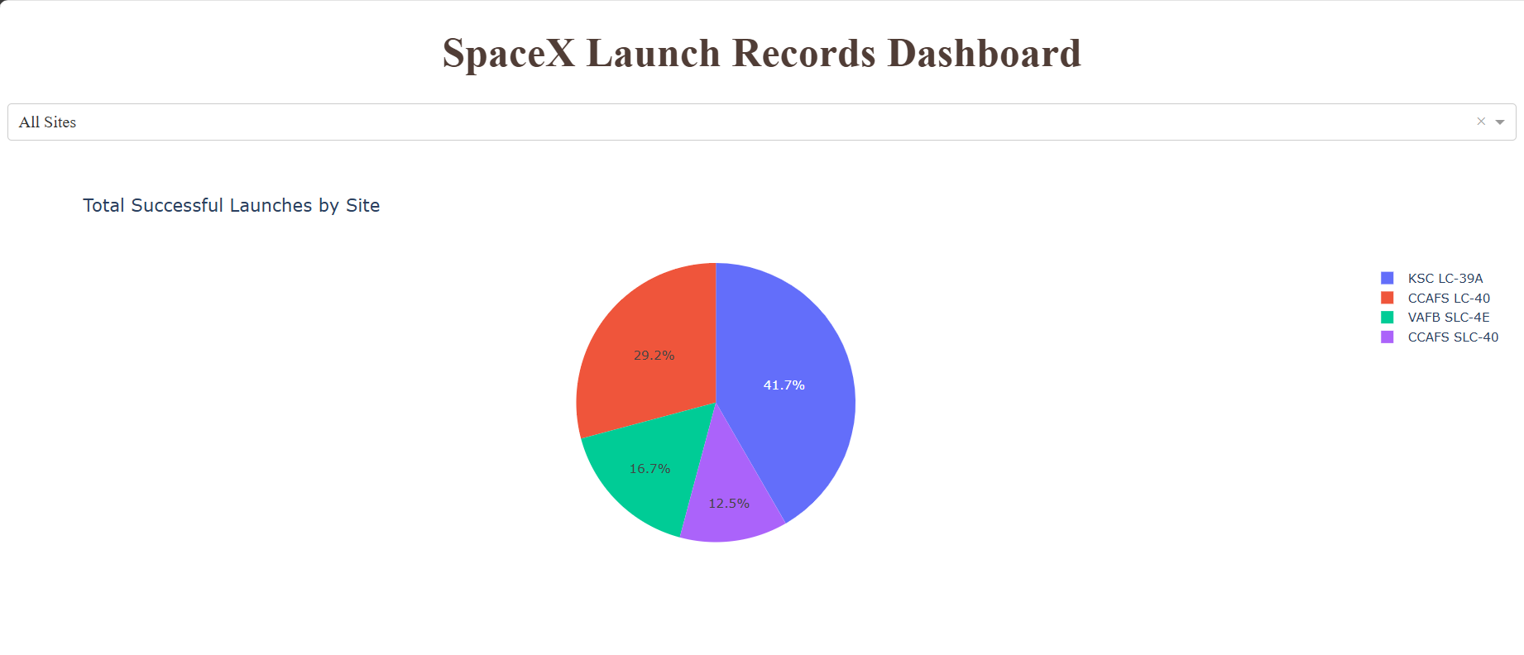
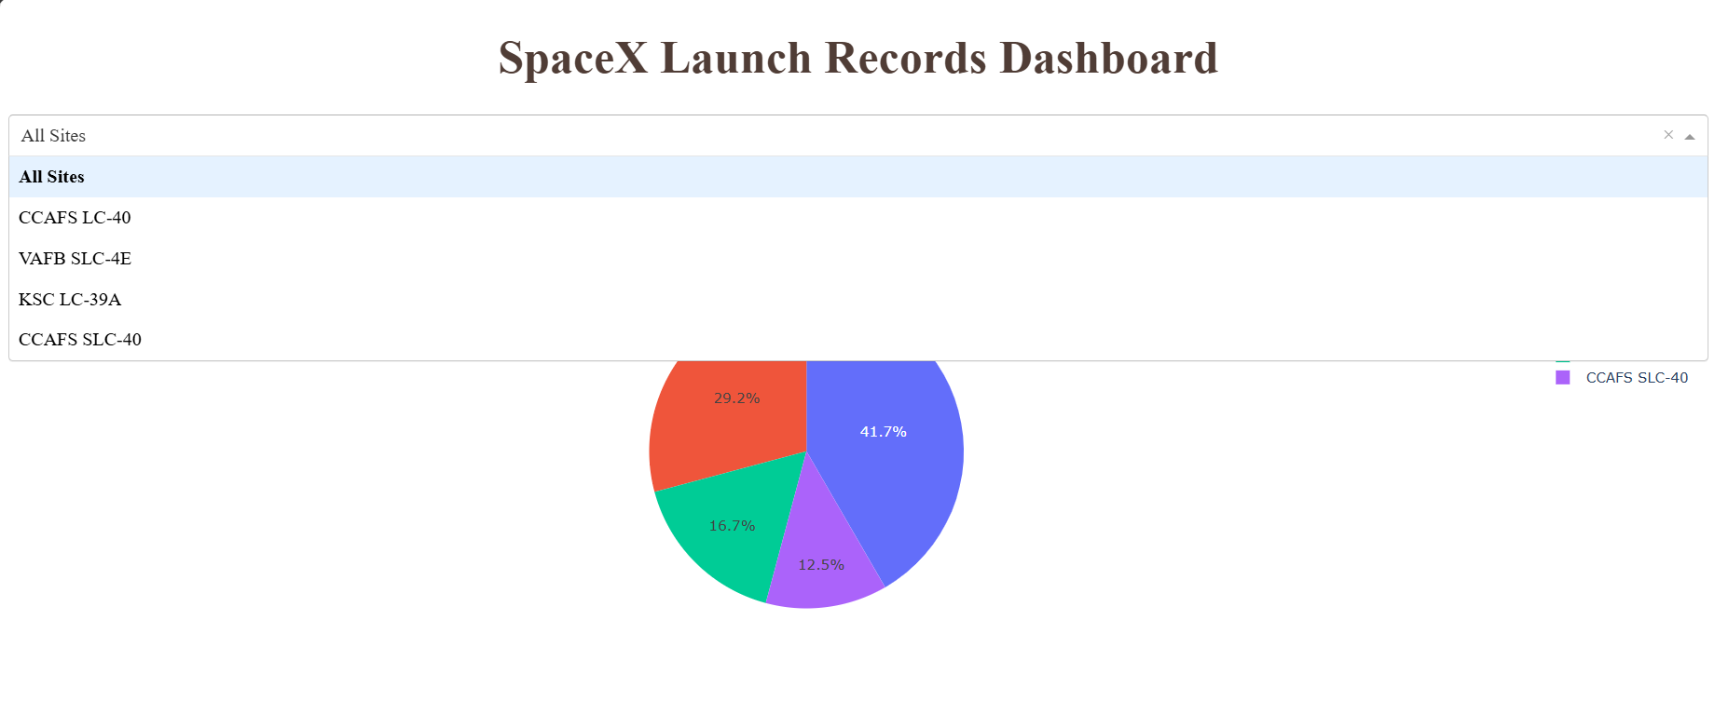
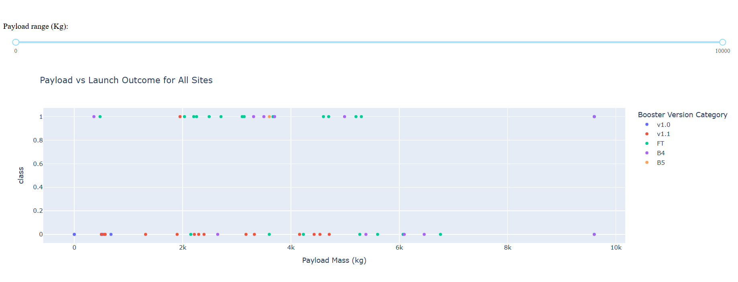
Results
A
A. Pie chart to show the total successful launches count for all sites
B
B. Dropdown list to enable Launch Site selection
C
C. Slider to select payload range

Slide 19
Results
Exploratory Data Analysis Results
Launch success rate increased significantly over time, reflecting SpaceX’s iterative improvements in booster recovery.
Payload mass showed a strong relationship with landing success: heavier payloads were more likely to result in controlled ocean landings rather than successful recoveries.
Certain orbits (e.g., LEO and ISS missions) exhibited higher landing success rates compared to high-energy orbits.
Ground pad landings achieved higher success rates than drone ship landings, indicating operational constraints in maritime recoveries.
Launch site analysis revealed performance differences across sites, influenced by mission profiles and orbital requirements.
Predictive Analysis Results
Multiple classification models—Logistic Regression, SVM, Decision Tree, and KNN—were trained and optimized using GridSearchCV.
Logistic Regression, SVM, and KNN achieved the highest test accuracy (83.3%), while Decision Tree showed slightly lower performance (77.8%).
Identical confusion matrices for Logistic Regression, SVM, and KNN suggest consistent decision boundaries and similar model behavior on the dataset.
Misclassifications were primarily false positives, indicating overlap in feature space rather than model inadequacy.
Logistic Regression was selected as the final model due to its strong performance, interpretability, and computational efficiency.

Slide 20

Section 2

Slide 21
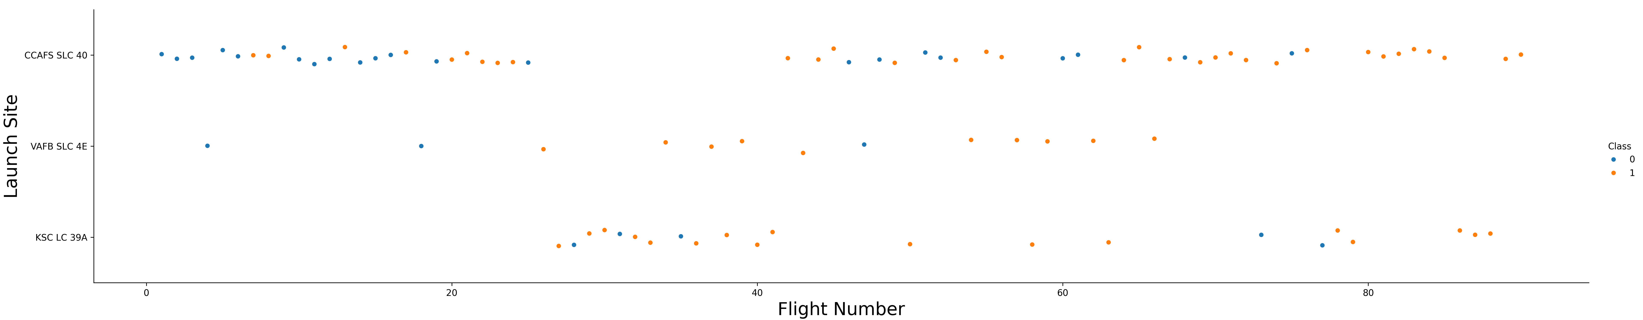
Flight Number vs. Launch Site
This scatter plot tracks the chronological progress of launches at three primary sites: CCAFS SLC 40, VAFB SLC 4E, and KSC LC 39A.
Success Trends: Success (represented by Class 1, orange) becomes significantly more frequent as flight numbers increase, particularly after Flight 40.
Site Usage: CCAFS SLC 40 handles the highest volume of early flights, while KSC LC 39A shows a high density of successful launches in the mid-to-later stages of the program.

Slide 22
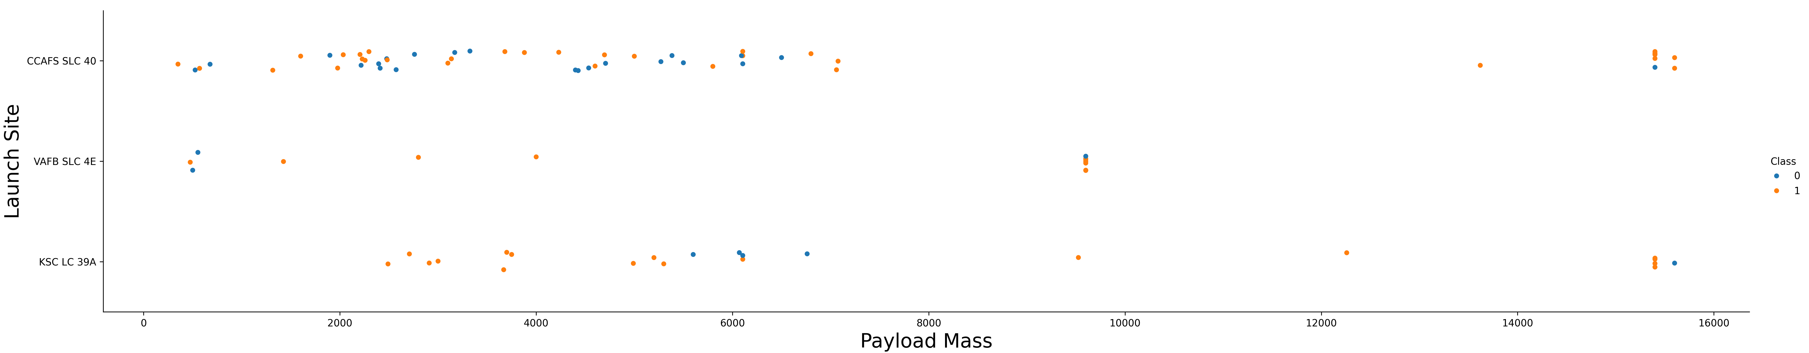
Payload vs. Launch Site
This plot illustrates how payload weight correlates with landing success at specific sites. If you observe Payload Mass Vs. Launch Site scatter point chart you will find for the VAFB-SLC launchsite there are no rockets launched for heavy payload mass (greater than 10000).
Heavy Payloads: There is a distinct cluster of heavy payloads (approx. 15,000 kg) across all sites, most of which resulted in successful landings.
VAFB SLC 4E: This site appears to handle a specific range of payloads, with a noticeable gap between light (under 2,000 kg) and heavy (around 10,000 kg) missions.

Slide 23
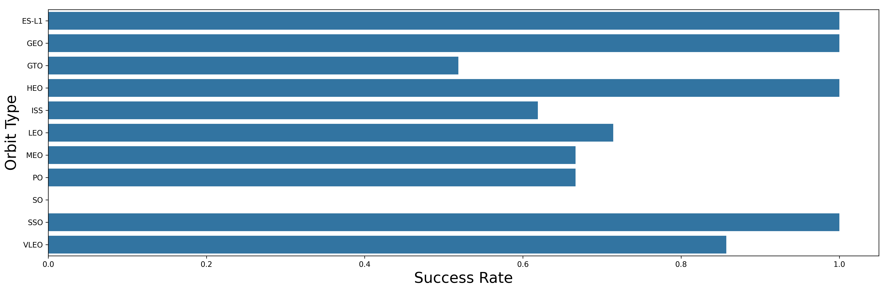
Success Rate vs. Orbit Type
This bar chart provides a clear comparison of reliability across different orbital destinations.
Top Performers: Orbits like ES-L1, GEO, HEO, and SSO show a 100% success rate.
Underperformers: The SO (Sun-Synchronous Orbit) shows a 0% success rate in this dataset, and GTO (Geostationary Transfer Orbit) sits at roughly 50%.

Slide 24
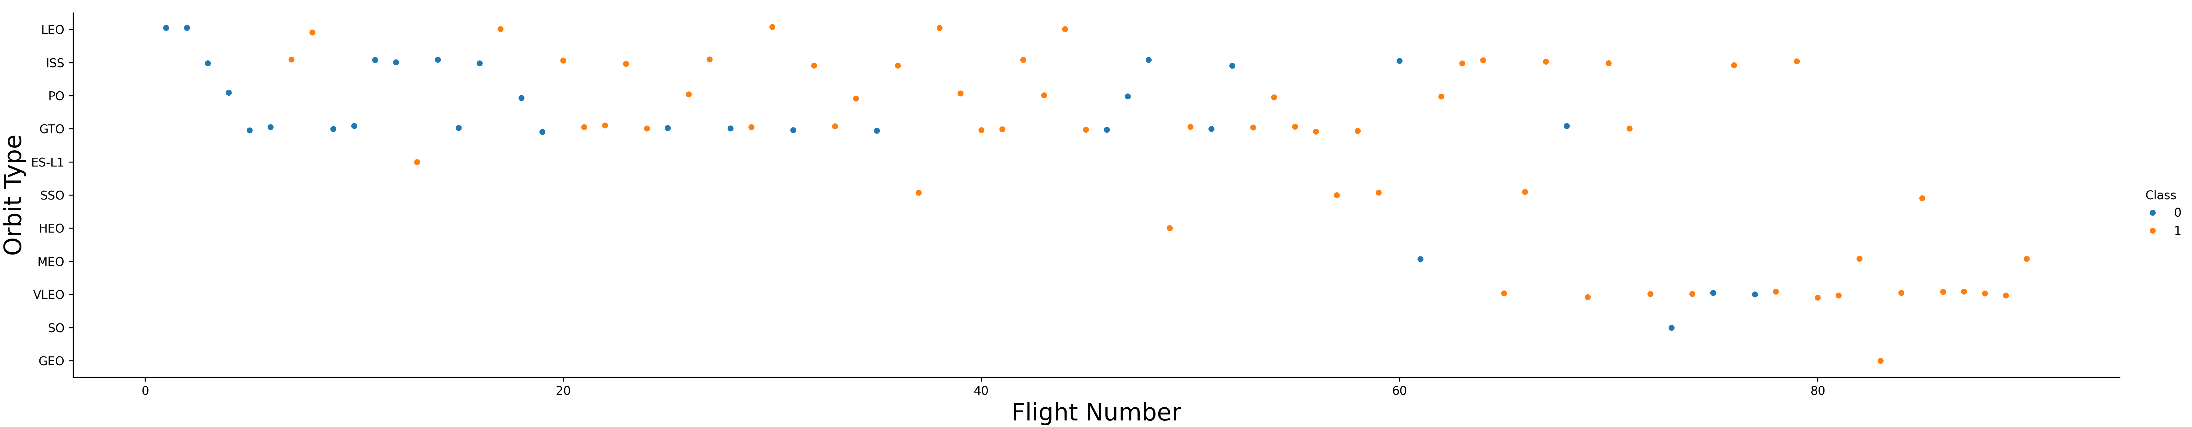
Flight Number vs. Orbit Type
This scatter plot maps the chronological transition of missions across various orbits. You can observe that in the LEO orbit, success seems to be related to the number of flights. Conversely, in the GTO orbit, there appears to be no relationship between flight number and success.
Early vs. Late: Early flights (1–20) were heavily focused on LEO, ISS, and GTO.
Success Improvement: Similar to the launch site plot, success rates across almost all orbit types improve as flight numbers increase, suggesting a maturation of the landing technology over time.

Slide 25
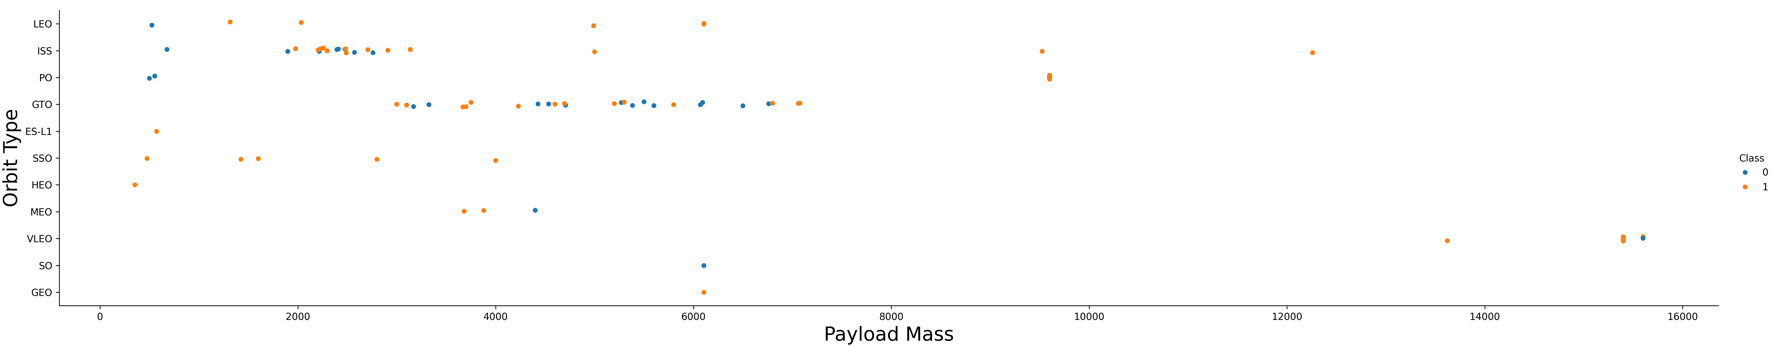
Payload vs. Orbit Type
This plot analyzes whether payload weight influences success for specific orbits. With heavy payloads the successful landing or positive landing rate are more for Polar, LEO and ISS. However, for GTO, it's difficult to distinguish between successful and unsuccessful landings as both outcomes are present.
LEO/ISS: These orbits show a mix of success and failure across lower payload masses.
High-Mass Success: Missions to VLEO (Very Low Earth Orbit) involve some of the highest payload masses in the dataset (around 15,000 kg).

Slide 26
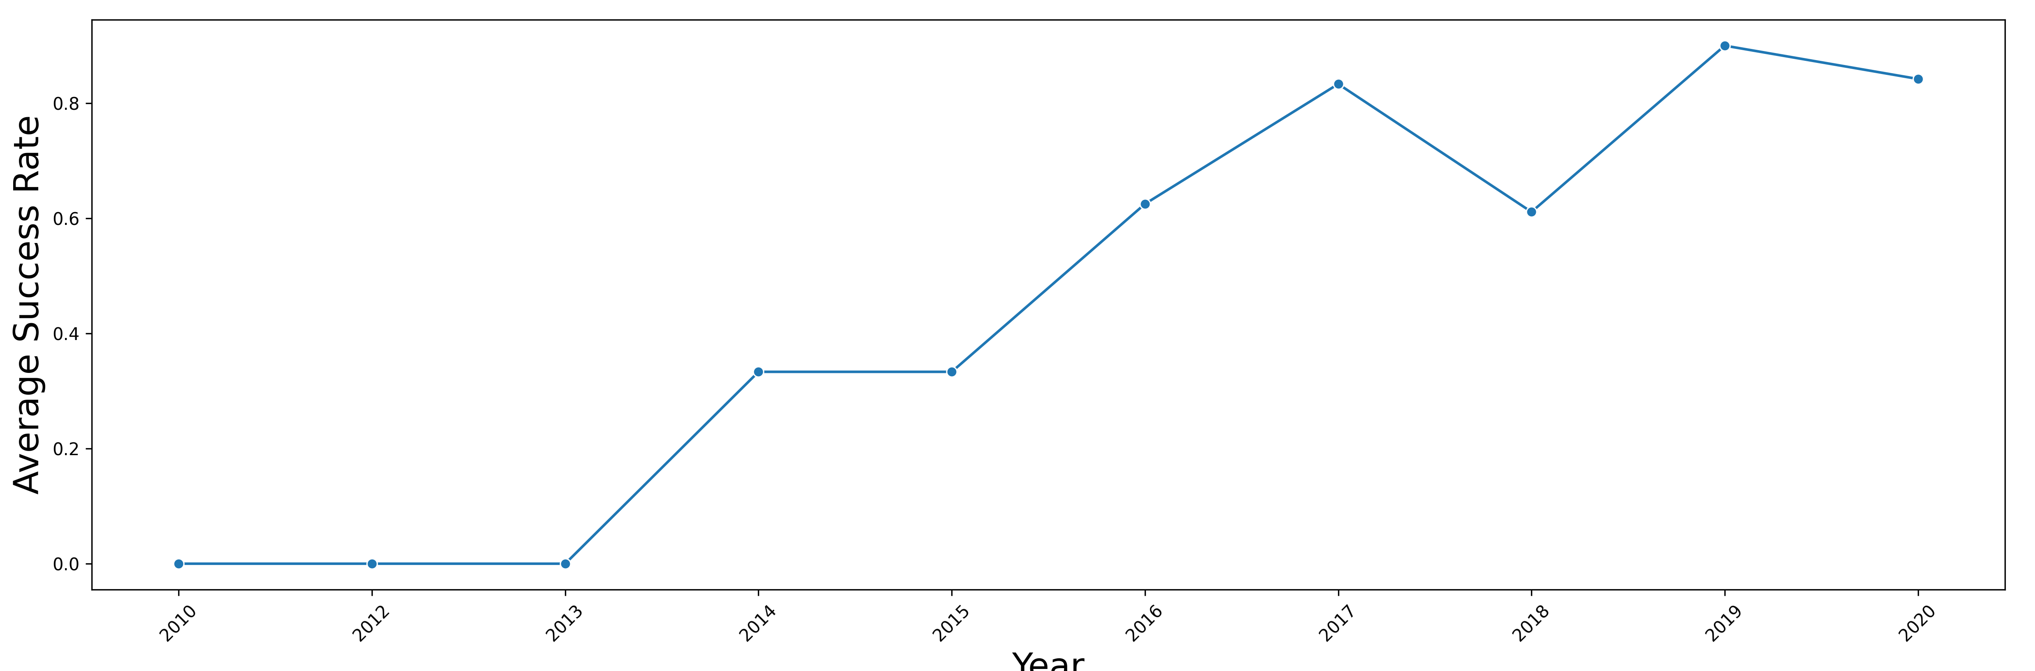
Launch Success Yearly Trend
This line graph tracks the overall performance of SpaceX launches by year (2010–2020). You can observe that the success rate since 2013 kept increasing till 2020
Initial Phase (2010–2013): The success rate remained at 0, reflecting the experimental phase of booster recovery.
Growth Phase: A sharp upward trajectory began in 2013, peaking in 2019 at roughly 90%.
Dip in 2018: There is a slight drop in the success rate in 2018 before it rebounded to its highest point.

Slide 27
All Launch Site Names
Launch Sites
CCAFS LC-40
VAFB SLC-4E
KSC LC-39A
CCAFS SLC-40
The dataset contains four unique Falcon 9 launch sites
Each site supports different orbital inclinations and mission profiles
Launch site diversity reflects SpaceX’s operational flexibility

Slide 28
Launch Site Names Begin with 'CCA'
Date | Time (UTC) | Booster_Version | Launch_Site | Payload | PAYLOAD_MASS__KG_ | Orbit | Customer | Mission_Outcome | Landing_Outcome
2010-06-04 | 18:45:00 | F9 v1.0 B0003 | CCAFS LC-40 | Dragon Spacecraft Qualification Unit | 0 | LEO | SpaceX | Success | Failure (parachute)
2010-12-08 | 15:43:00 | F9 v1.0 B0004 | CCAFS LC-40 | Dragon demo flight C1, two CubeSats, barrel of Brouere cheese | 0 | LEO (ISS) | NASA (COTS) NRO | Success | Failure (parachute)
2012-05-22 | 7:44:00 | F9 v1.0 B0005 | CCAFS LC-40 | Dragon demo flight C2 | 525 | LEO (ISS) | NASA (COTS) | Success | No attempt
2012-10-08 | 0:35:00 | F9 v1.0 B0006 | CCAFS LC-40 | SpaceX CRS-1 | 500 | LEO (ISS) | NASA (CRS) | Success | No attempt
2013-03-01 | 15:10:00 | F9 v1.0 B0007 | CCAFS LC-40 | SpaceX CRS-2 | 677 | LEO (ISS) | NASA (CRS) | Success | No attempt
The query filters launch records where the launch site name begins with “CCA”, referring to Cape Canaveral Air Force Station
Multiple launches were conducted from CCAFS LC-40, indicating its frequent operational use
This site is primarily associated with low-Earth orbit (LEO) and ISS resupply missions

Slide 29
Total Payload Mass
Total Payload Mass = 45596 Kg
Computed the total payload mass delivered by Falcon 9 boosters for NASA Commercial Resupply Services (CRS) missions
Used the SUM aggregation function on PAYLOAD_MASS__KG_
Applied a customer-level filter to isolate NASA CRS launches only
Insights
Indicates the overall contribution of Falcon 9 missions to NASA resupply operations
Highlights SpaceX’s role in delivering large cumulative payloads to orbit
Reinforces the importance of booster reusability in reducing long-term launch costs for government missions

Slide 30
Average Payload Mass by F9 v1.1
Average Payload Mass = 2928.4 Kg
Used the AVG aggregation function to compute the mean payload mass
Filtered records to include only Falcon 9 v1.1 launches
Result reflects the typical payload capacity of the F9 v1.1 booster
Insights
Provides a baseline reference for comparing payload capabilities across Falcon 9 variants
Helps assess performance evolution of SpaceX launch vehicles

Slide 31
First Successful Ground Landing Date
First Successful Ground Landing Date: December 22, 2015
Used the MIN() aggregation function to identify the earliest date
Filtered launches with a successful ground pad landing outcome
Result represents the first recorded successful ground landing by SpaceX
Insights
Marks a key technological milestone in Falcon 9 reusability
Demonstrates SpaceX’s early success in controlled booster recovery on land

Slide 32
Successful Drone Ship Landing with Payload between 4000 and 6000
Filtered launches with successful drone ship landings
Restricted payload mass to the medium-heavy range (4000–6000 kg)
Used DISTINCT to list only unique booster versions meeting the criteria
Insights
Demonstrates that drone ship recovery is reliable even at higher payload masses
Identifies booster variants capable of balancing payload capacity and landing success
Supports the operational strategy of using drone ships for energy-intensive missions where ground landings are not feasible
Booster_Version
F9 FT B1022
F9 FT B1026
F9 FT B1021.2
F9 FT B1031.2

Slide 33
Total Number of Successful and Failure Mission Outcomes
Grouped all launches by Mission Outcome
Counted the number of records for each outcome using COUNT(*)
Provides an overall distribution of successful vs. failed missions
Insights
The results show that successful missions significantly outnumber failures, reflecting SpaceX’s high operational reliability
The imbalance toward success supports the feasibility of booster reusability and cost reduction
Failure records remain important for identifying edge cases and risk factors used later in predictive modeling
Mission_Outcome | Total
Failure (in flight) | 1
Success | 98
Success | 1
Success (payload status unclear) | 1

Slide 34
Boosters Carried Maximum Payload
Booster_Version
F9 B5 B1048.4
F9 B5 B1049.4
F9 B5 B1051.3
F9 B5 B1056.4
F9 B5 B1048.5
F9 B5 B1051.4
F9 B5 B1049.5
F9 B5 B1060.2
F9 B5 B1058.3
F9 B5 B1051.6
F9 B5 B1060.3
F9 B5 B1049.7
Identified the maximum payload mass using a subquery with MAX(PAYLOAD_MASS__KG_)
Retrieved the booster version(s) that carried this maximum payload
Used DISTINCT to avoid duplicate booster entries
Insights
The booster version(s) listed represent SpaceX’s highest payload-capable configurations
These boosters are typically associated with later-generation Falcon 9 variants, reflecting engineering improvements over time
High payload capability is often linked with more demanding missions, which may influence landing success probability and recovery strategy

Slide 35
2015 Launch Records
Month | Landing_Outcome | Booster_Version | Launch_Site
01 | Failure (drone ship) | F9 v1.1 B1012 | CCAFS LC-40
04 | Failure (drone ship) | F9 v1.1 B1015 | CCAFS LC-40
Filtered launch records to year 2015 using substr(Date,0,5)
Selected only failed drone ship landings
Extracted month, booster version, and launch site to analyze temporal and operational context
Insights
The failures occurred during early Falcon 9 reusability attempts, when drone ship landings were still experimental
Affected booster versions reflect earlier Falcon 9 configurations, which had lower landing reliability compared to later versions
Certain launch sites appear more frequently, suggesting site-specific recovery challenges such as weather, trajectory, or range safety constraints
These 2015 failures highlight the learning curve that preceded SpaceX’s later high success rates in drone ship recoveries

Slide 36
Rank Landing Outcomes Between 2010-06-04 and 2017-03-20
Landing Outcome | Outcome Count
No attempt | 10
Success (drone ship) | 5
Failure (drone ship) | 5
Success (ground pad) | 3
Controlled (ocean) | 3
Uncontrolled (ocean) | 2
Failure (parachute) | 2
Precluded (drone ship) | 1
Filtered launch records between June 4, 2010 and March 20, 2017
Grouped launches by Landing_Outcome
Counted occurrences of each outcome and ranked them in descending order
Insights
Failure-related outcomes dominate the early years, reflecting SpaceX’s initial development and testing phase for reusable boosters
Ground pad successes appear earlier and more consistently than drone ship successes, indicating that land-based recovery was operationally simpler in the early stages
Drone ship successes increase closer to 2017, signaling significant improvements in guidance, control, and landing precision
The ranking clearly illustrates SpaceX’s progression from experimental landings to reliable recovery, supporting the trend observed in the EDA and predictive modeling stages

Slide 37

Section 3

Slide 38
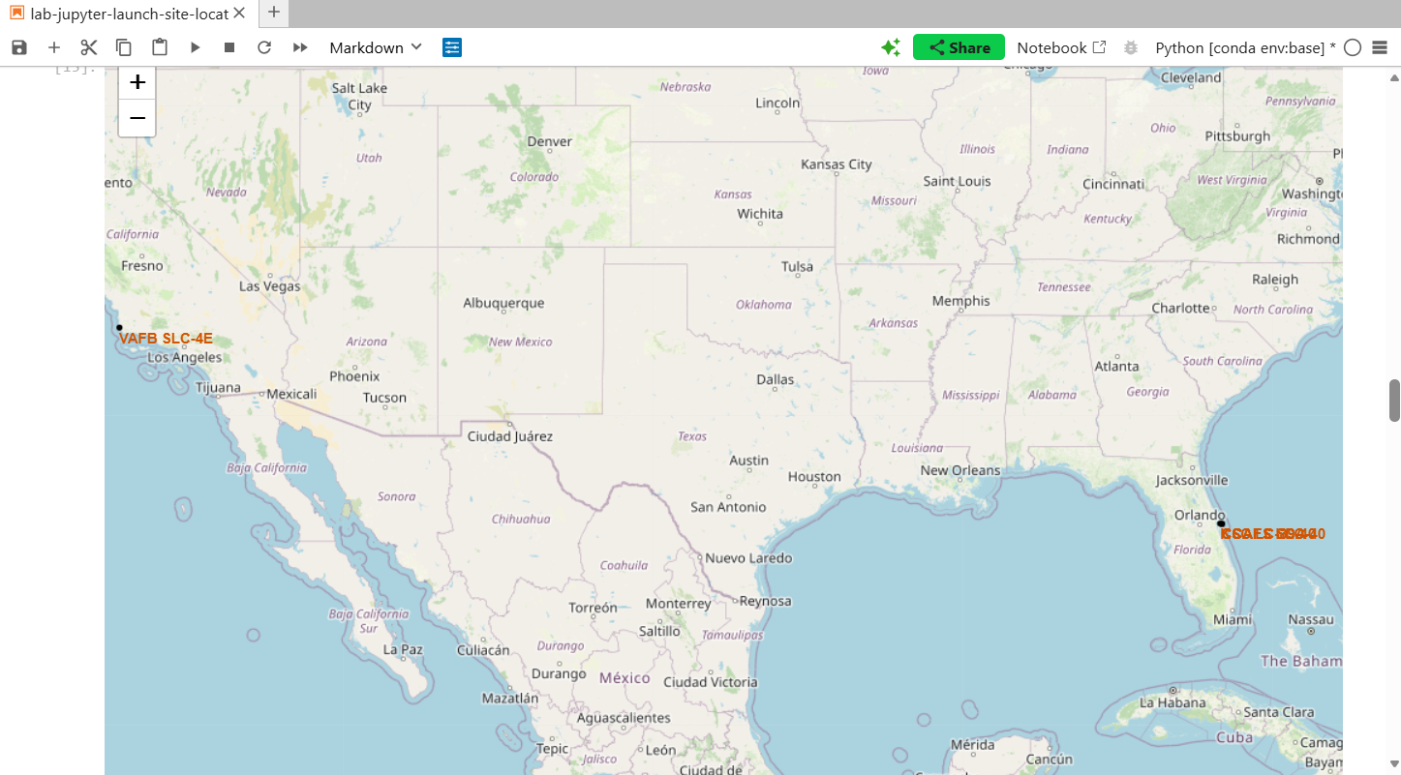
Geographical Distribution and Strategic Positioning of SpaceX Launch Sites
Most major SpaceX launch sites are located in the southern regions of the United States to be as close to the Equator as possible.
Sites like CCAFS SLC-40 and KSC LC-39A in Florida are at approximately 28° N latitude. While not at the Equator, they are in the southernmost part of the continental US to maximize the "boost" from the Earth's rotational speed, which is highest at the Equator. VAFB SLC-4E in California is further north at approximately 34° N.
All three primary launch sites are located directly on the coastline.
VAFB SLC-4E is on the Pacific coast of California while the other three are on the Atlantic coast of Florida. Coastal locations allow rockets to launch over open water, ensuring that spent stages or debris from a failed launch fall into the ocean rather than populated areas.

Slide 39
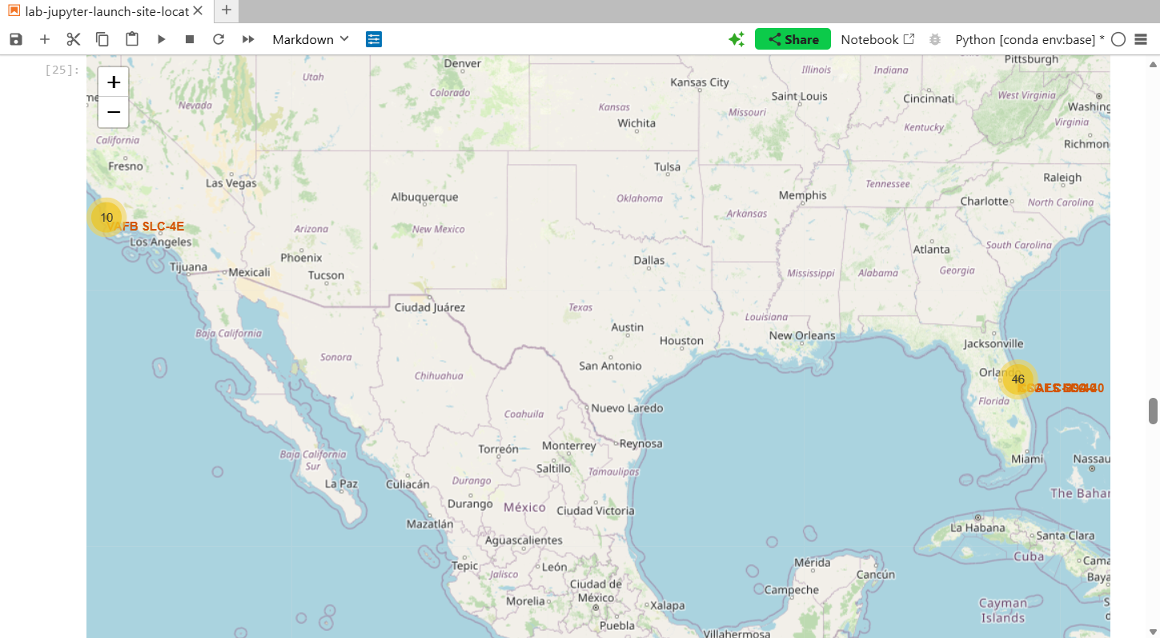
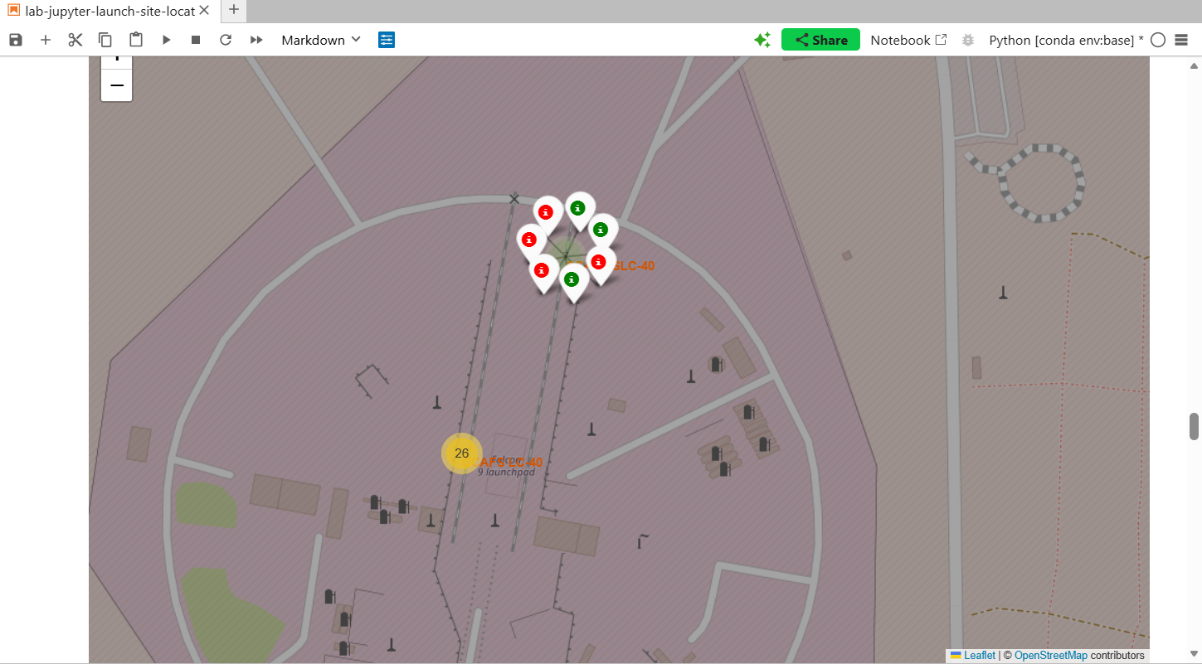
Visualizing Mission Outcomes: Success Rates Across Primary Launch Sites
CCAFS LC-40 has the lowest success rate, with a significantly higher number of failed landings (red markers), particularly in early missions, as shown in the screenshot.
KSC LC-39A shows the highest success rate, with a clear majority of launches resulting in successful landings (green markers dominate).
CCAFS SLC-40 also demonstrates a relatively high success rate, especially in later launches, indicating operational improvement over time.
VAFB SLC-4E exhibits a more balanced mix of successes and failures, resulting in a moderate overall success rate compared to Florida-based sites.
Overall, Florida launch sites (KSC LC-39A and CCAFS SLC-40) outperform Vandenberg (VAFB SLC-4E) in landing success, suggesting advantages related to mission profile, recovery strategy, or operational maturity.
*for the remaining launch sites, please refer to the interactive map included in the notebook for this activity, accessible via the GitHub link provided in the previous section.

Slide 40
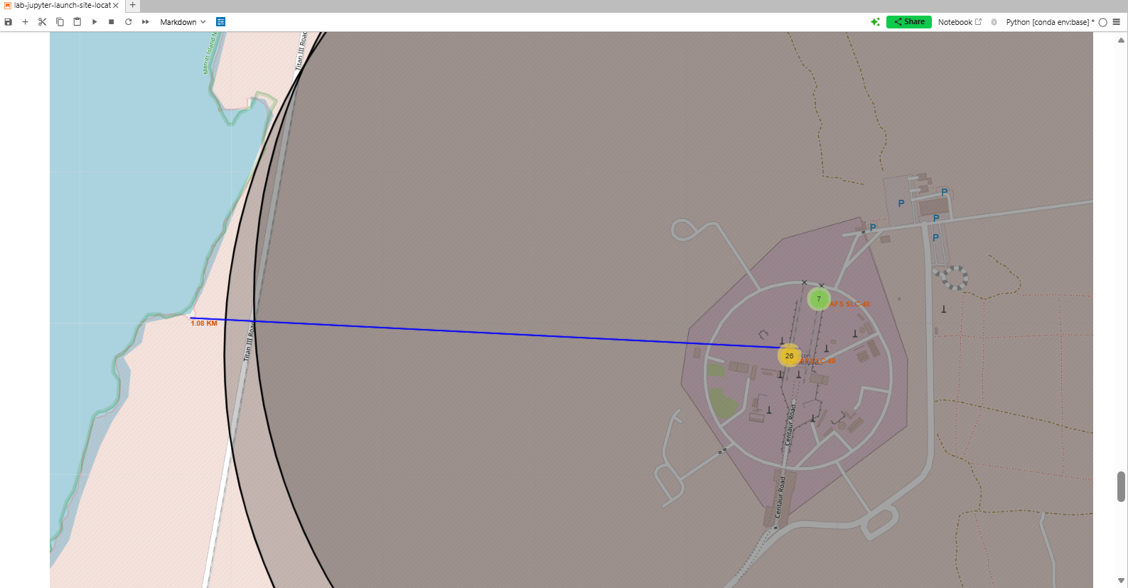
Launch Site Proximity
The launch sites are intentionally placed as close to the coastline as possible. Such an example is the CCAFS LC 40, located just 1.08 km away from the coastline.
Launch sites are located near railways to facilitate the delivery of heavy equipment and rocket stages that are too large for standard road transport. The closest railway to CCAFS LC 40 is just 1.69 km away.
Close access to major highways (such as Florida State Road A1A or CA-1) is essential for the daily commute of thousands of employees and the logistics of smaller hardware components. The closest highway to CCAFS LC 40 is just 2.15 km away.
Launch sites maintain a significant "buffer zone" from major population centers. This safety margin protects residents from the acoustic impact (noise/vibration) of launches and mitigates risks in the event of a flight anomaly or explosion. Although the closest city is only 1.08 km away, the nearest neighborhood is much farther away.
*Additional interactive maps are available in the notebook for this part of the project uploaded at GitHub (the link is given at the previous section.

Slide 41

Section 4

Slide 42
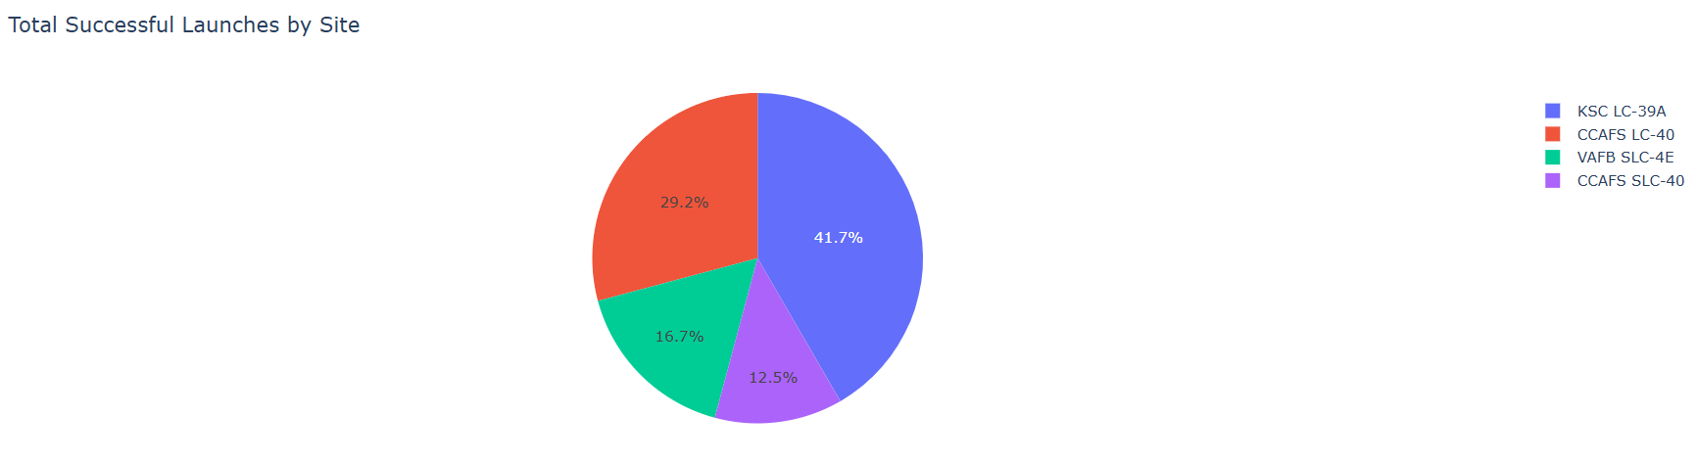
Aggregate Mission Outcomes Across SpaceX Launch Facilities
This pie chart breaks down the total volume of successful launches (Class 1) contributed by each site. KSC LC-39A typically accounts for the largest "slice" of total successes in these datasets, reflecting its role as a primary high-cadence site for SpaceX. CCAFS SLC-40 often shows the highest total mission count, but because it handled many early development flights, its share of the total "success pie" may be lower proportionally compared to the more modern operations at KSC.

Slide 43
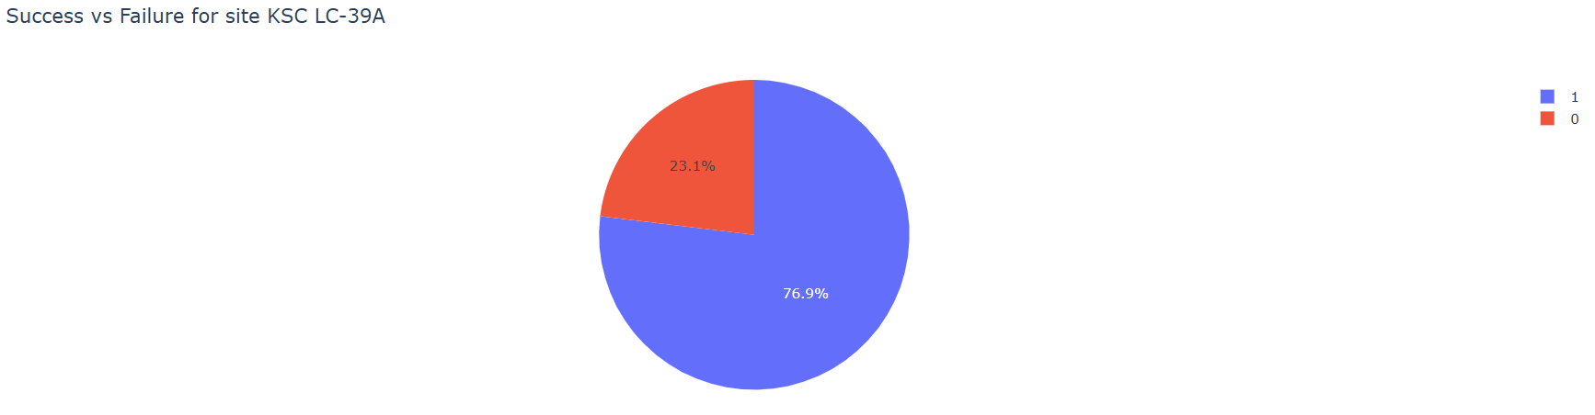
Top Performance Leader: Success vs. Failure Ratio at KSC LC-39A
This chart focuses exclusively on the site with the best performance (KSC LC-39A), showing a direct comparison between successful (Class 1) and failed (Class 0) outcomes. For this specific site, the chart is dominated by success. Data indicates that KSC LC-39A has achieved success rates as high as 77% depending on the specific flight window analyzed, significantly outperforming earlier sites like SLC-40.

Slide 44
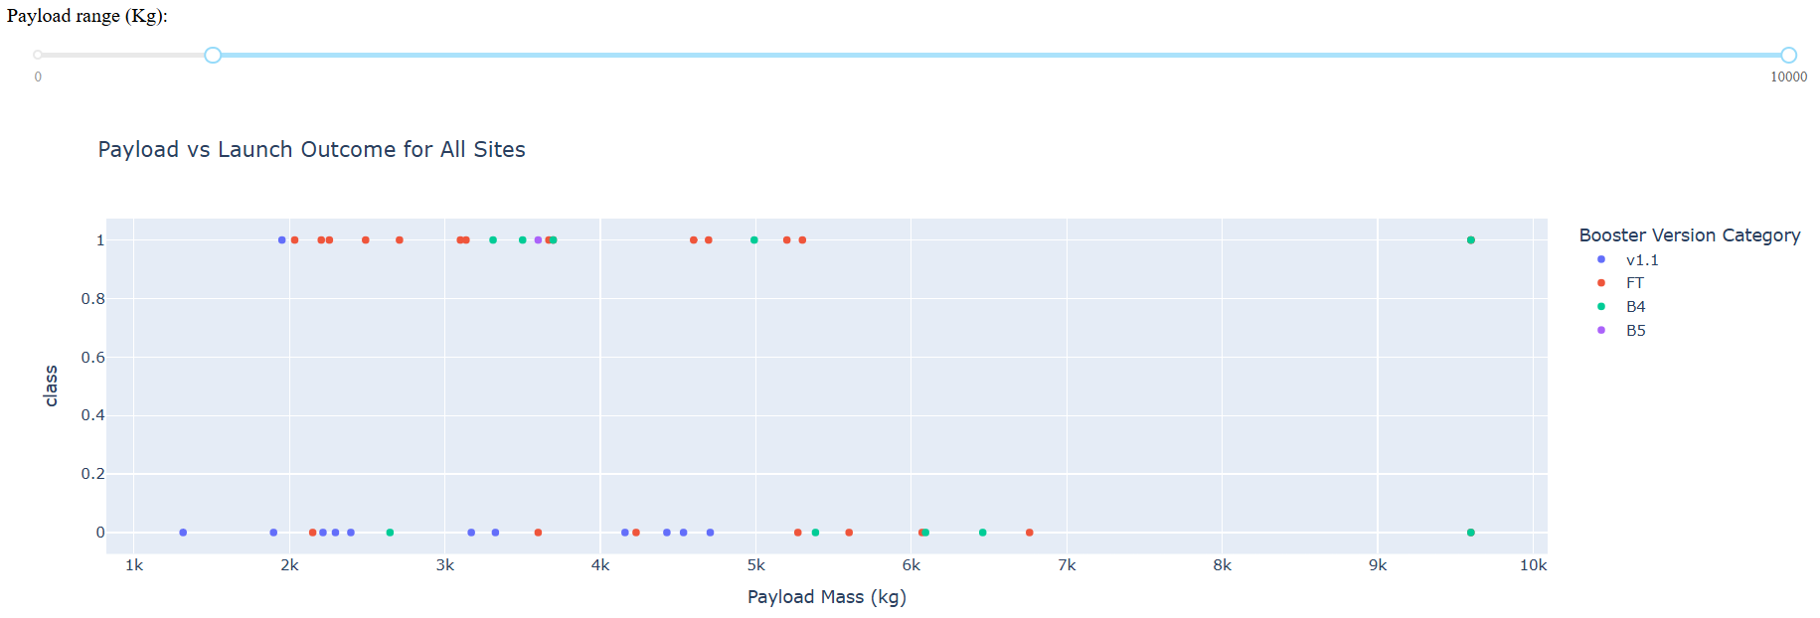
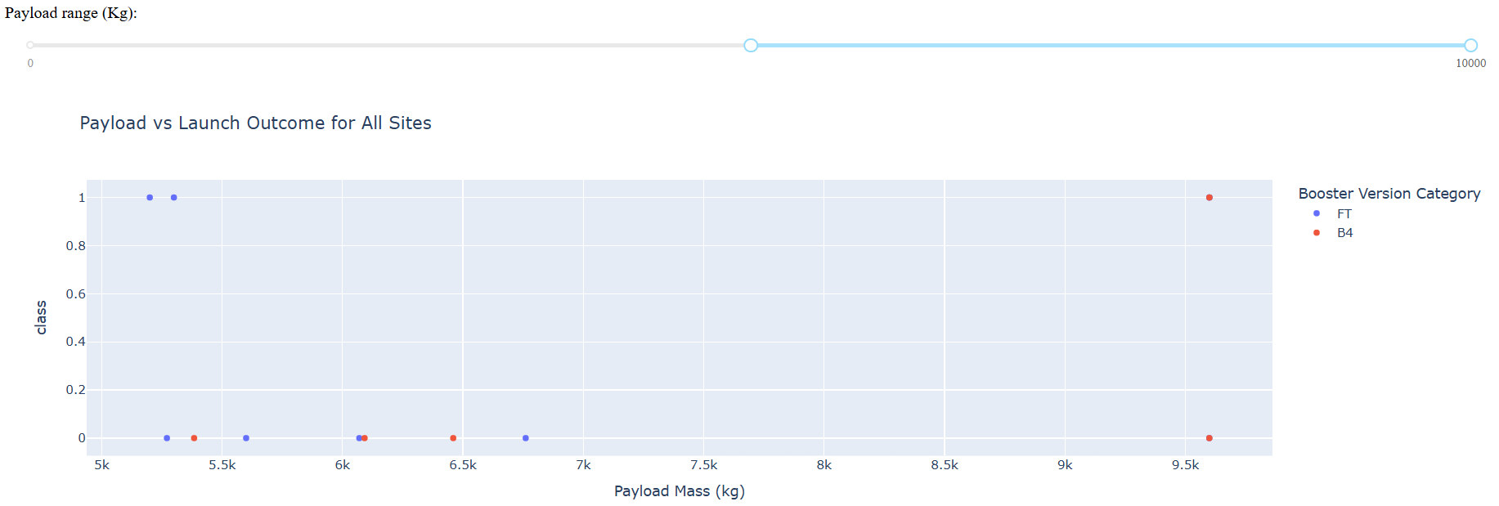
Correlation Between Payload Mass, Booster Version, and Mission Success
These scatter plots use a range slider to filter missions by payload mass (kg) while color-coding results by Booster Version (e.g., v1.1, FT, B4, B5).
The Block 5 (B5) booster version has the highest success rate.
Success is consistently high for heavy payloads particularly for missions to Very Low Earth Orbit (VLEO) using the Block 5 boosters.
Earlier versions like v1.1 show a higher concentration of "Class 0" failures, primarily at lower payload ranges representing the developmental phase of booster landing technology.

Slide 45

Section 5

Slide 46
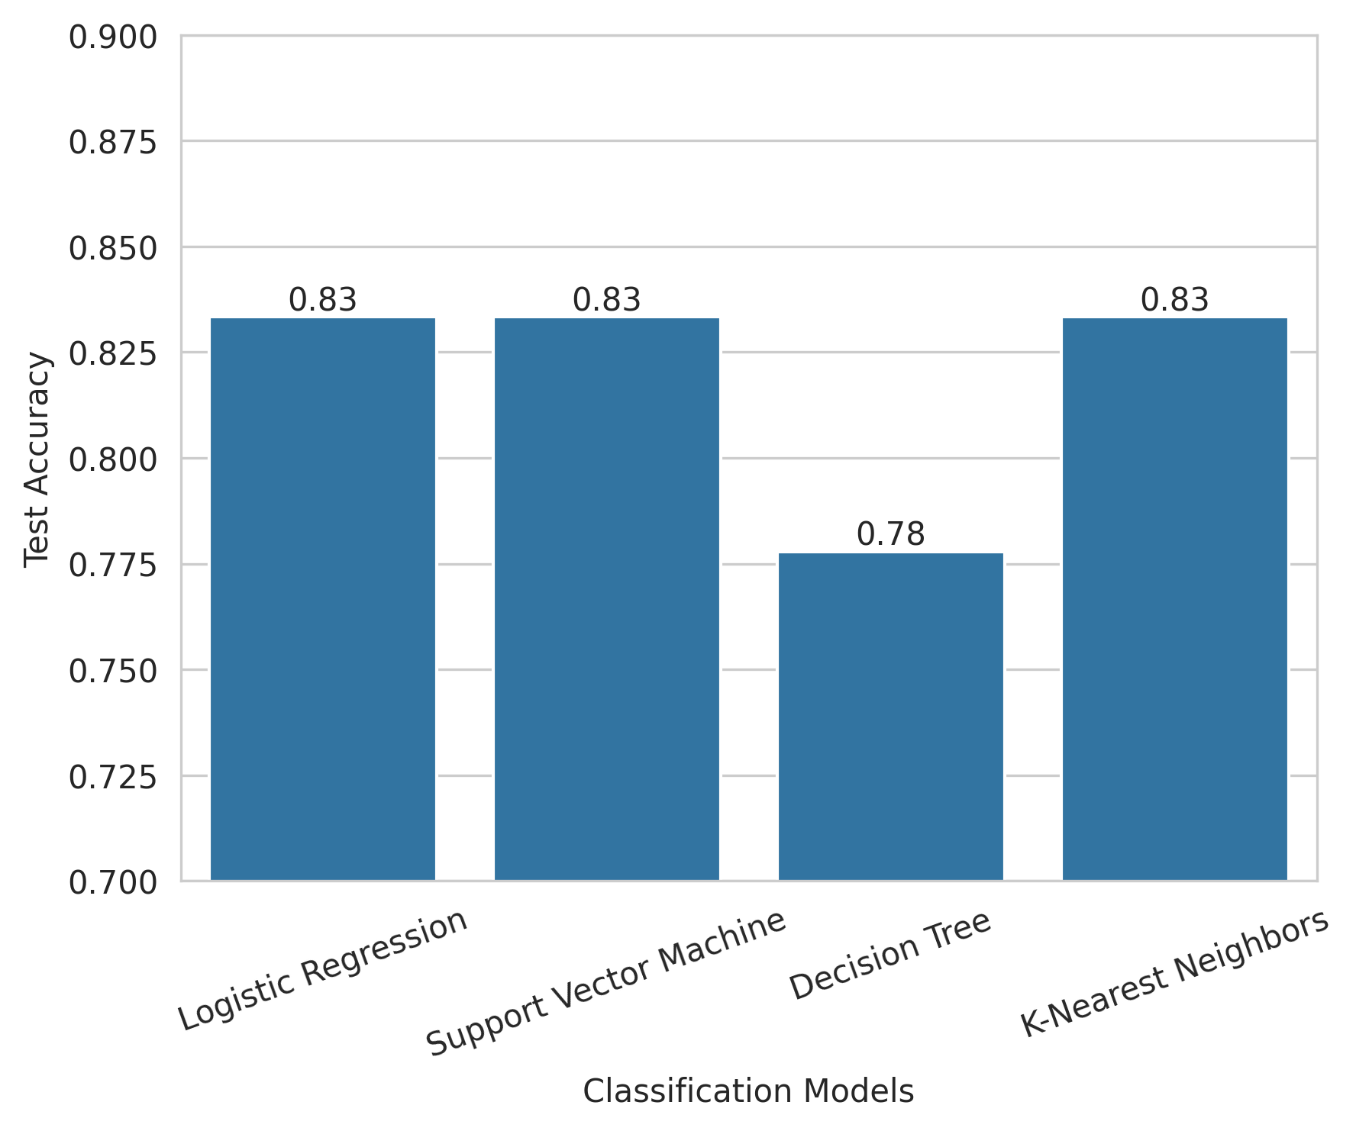
Classification Accuracy
Logistic Regression, SVM, and KNN achieved the highest accuracy (83.3%); The Decision Tree model only scored 77.8% accuracy.
Logistic Regression was selected as the final model due to:
Comparable accuracy
Simplicity and interpretability
Lower computational complexity

Slide 47
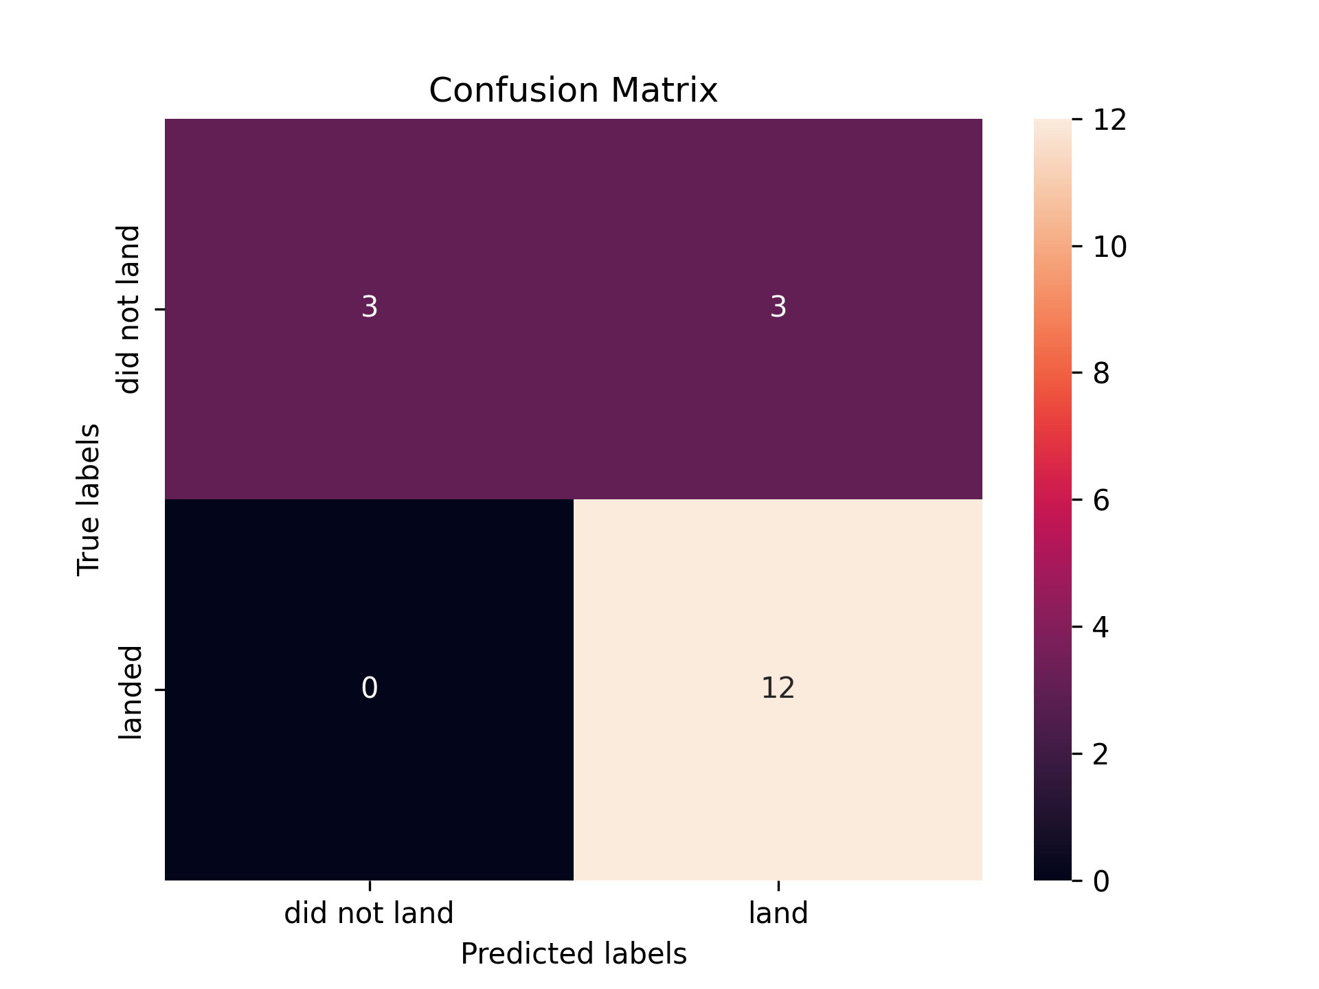
Confusion Matrix
12 successful landings were correctly predicted as landed (True Positives).
3 failed landings were correctly predicted as failures (True Negatives).
3 failed landings were misclassified as successful (False Positives).
No successful landings were misclassified as failures (False Negatives = 0).
The models demonstrate excellent recall for successful landings, meaning they consistently identify successful outcomes.
There is some confusion in predicting failures, where a few failed landings are predicted as successful.

Slide 48
Conclusions
Launch success is strongly influenced by launch site location, payload mass, and booster version.
KSC LC-39A and VAFB SLC-4E show higher success rates compared to other launch sites.
Classification models (LogReg, SVM, and KNN) achieved high accuracy, with excellent detection of successful landings.
Confusion matrix results show zero missed successful landings, indicating strong recall for landing success.
Minor misclassification occurs for failed landings, suggesting room for improvement in failure prediction.

Slide 49
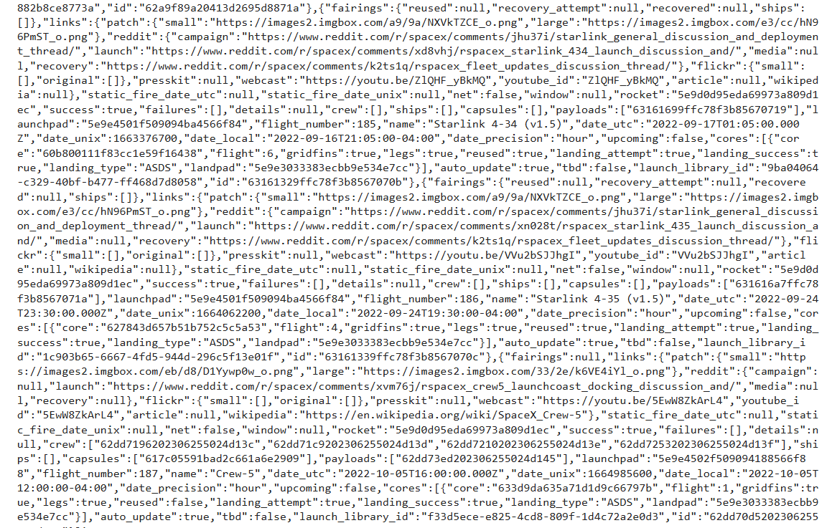
Appendix
A snippet of the JSON file containing rocket launch data from SpaceX API

Slide 50
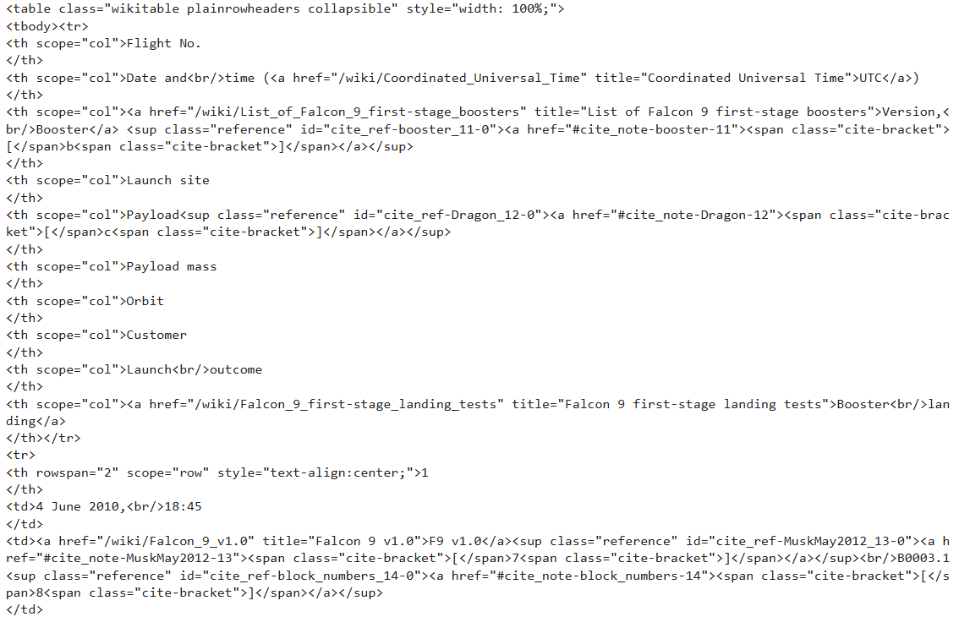
Appendix
A snippet of the HTML table produced during web scraping via BeautifulSoup

Slide 51
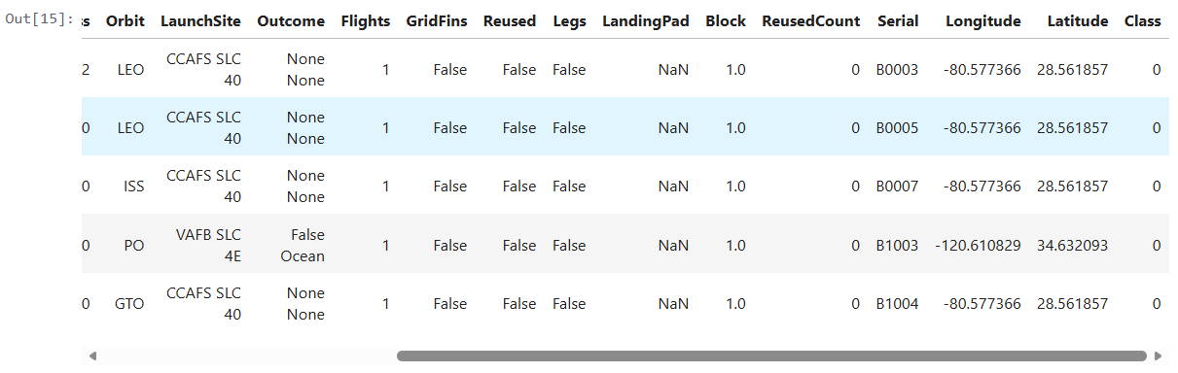
Appendix
Parts of dataframe showing created landing outcome labels during data wrangling

Slide 52
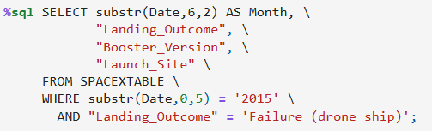
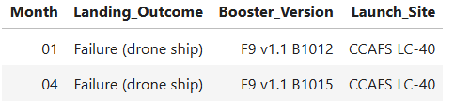
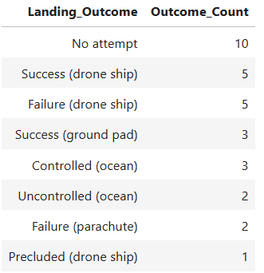
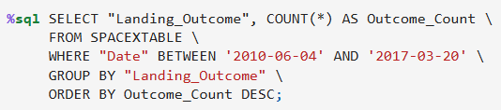
Appendix
Some SQL commands and their appropriate response used for EDA

Slide 53
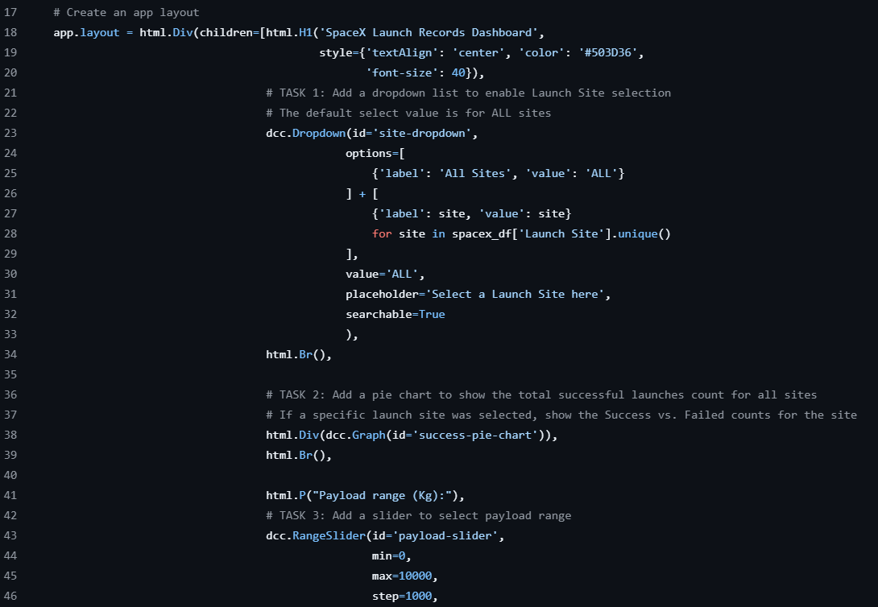
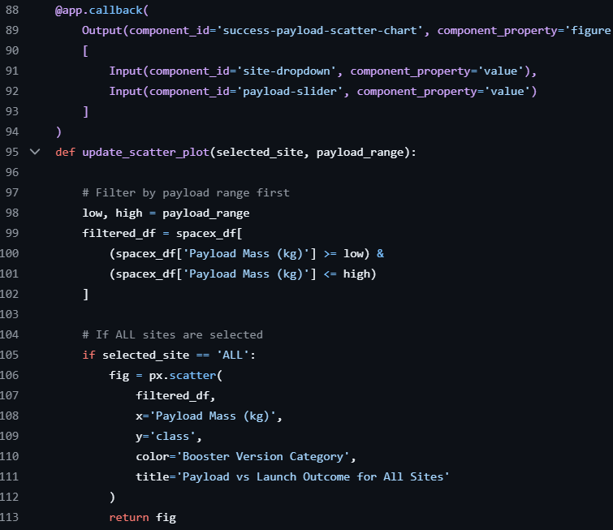
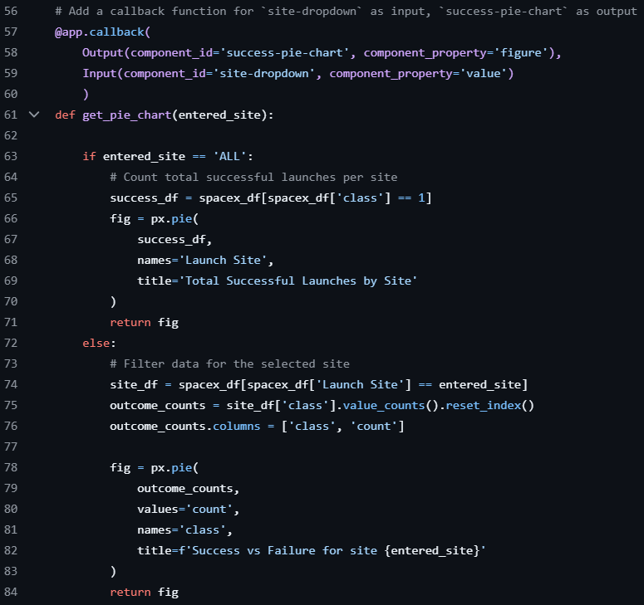
Appendix
Snippets of the code used to build the SpaceX dashboard using Plotly and Dash

Slide 54
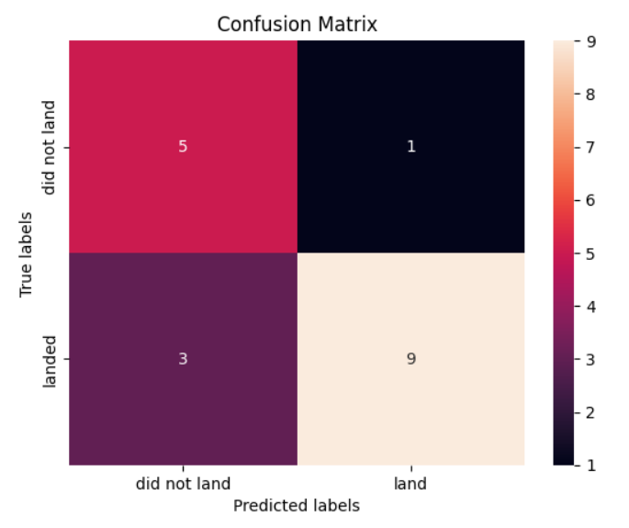
Appendix
The confusion matrix of the Decision Tree model, which garnered the lowert test accuracy among the models

Slide 55


